Slide 1
Transformers
One
Sarah Smeltzer and Grace Hough

Slide 2
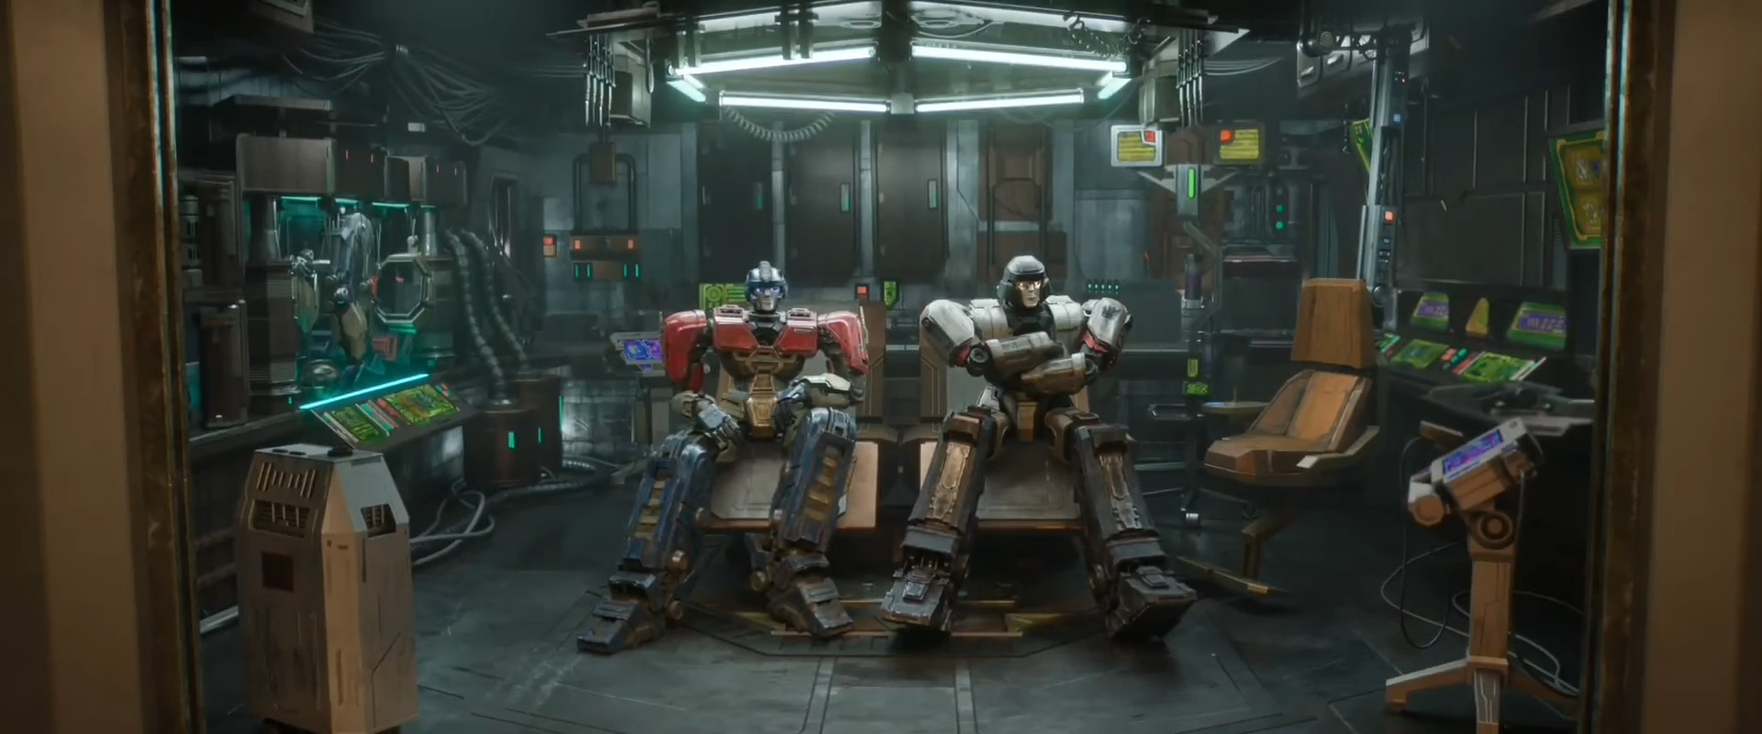
Original

Slide 3



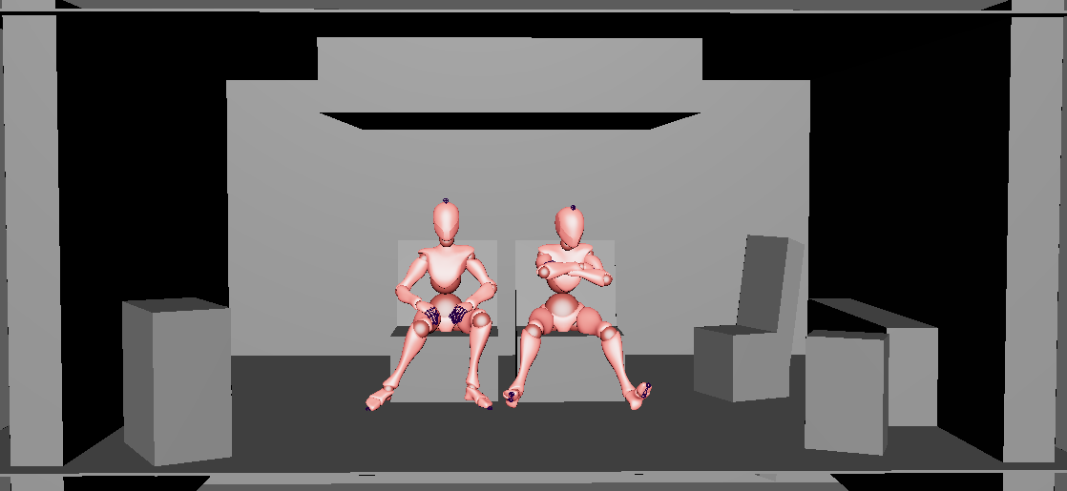
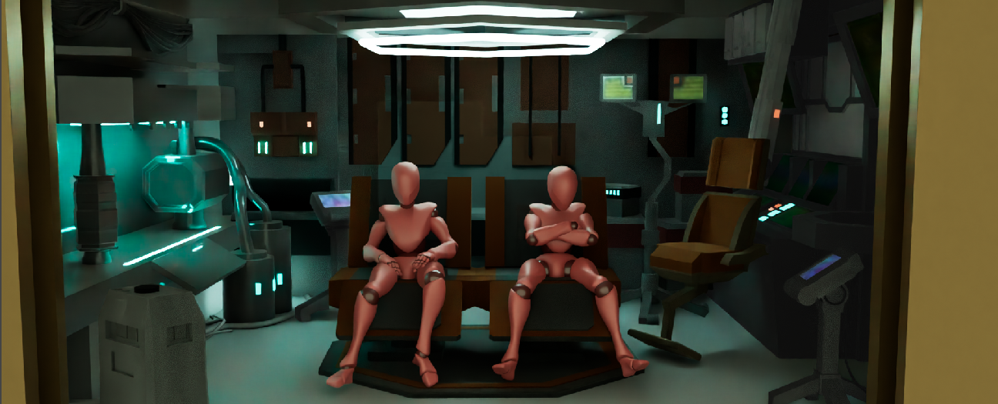
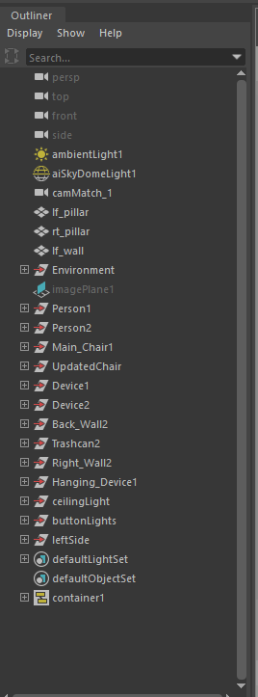
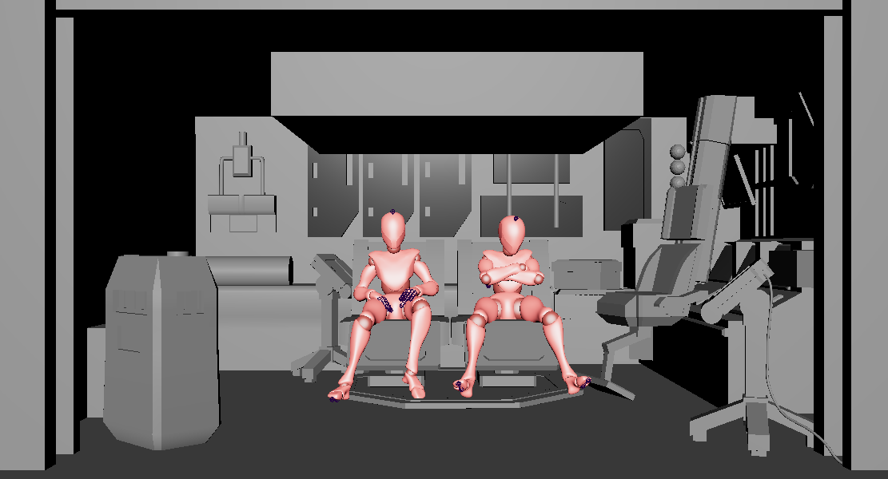
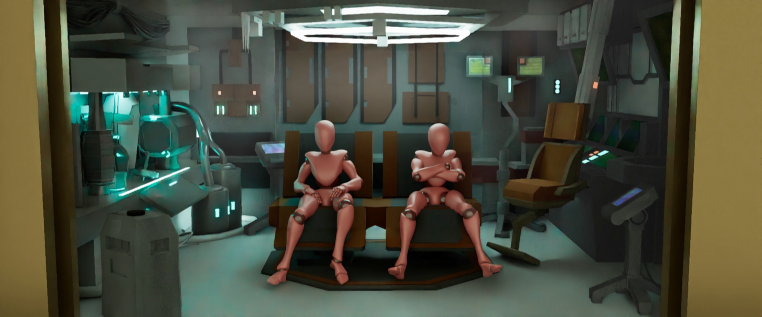
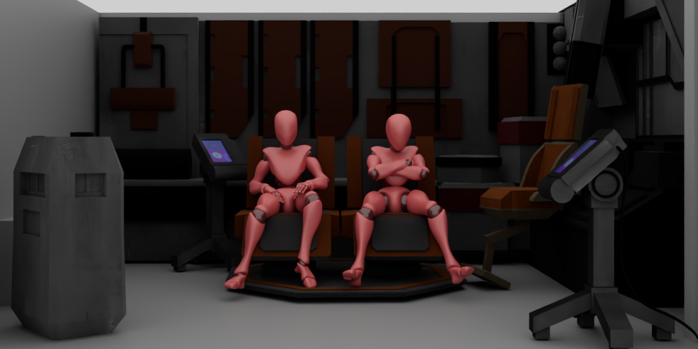
Process
GITHUB Link
Notes:
Sarah: Models on right side and back wall, trashcan, final render with atmosphere.
Grace: Models on left side

Slide 4
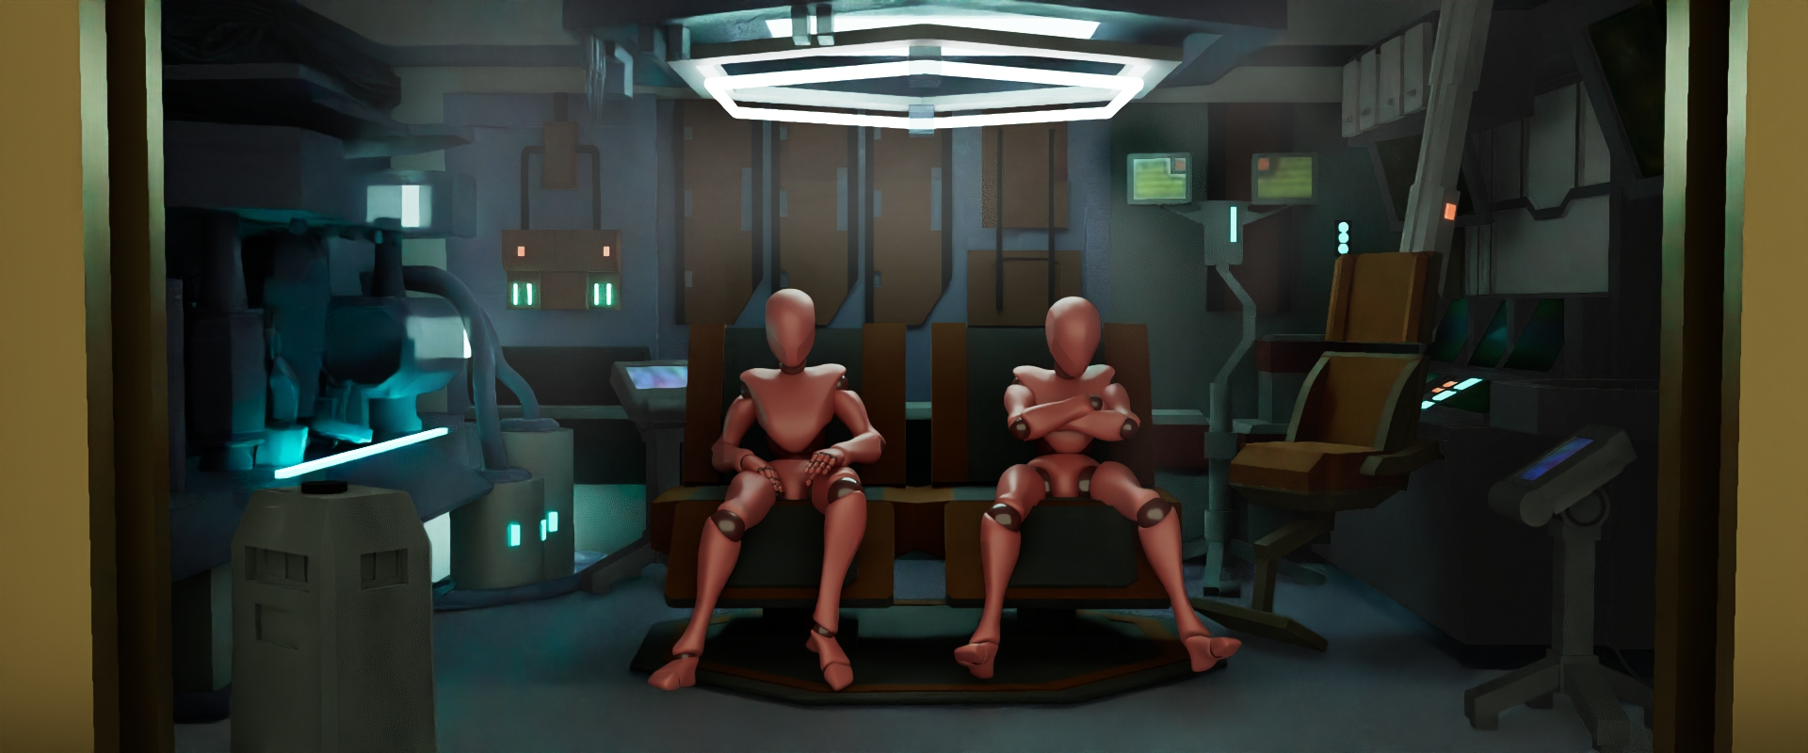
Final Renders

Slide 5
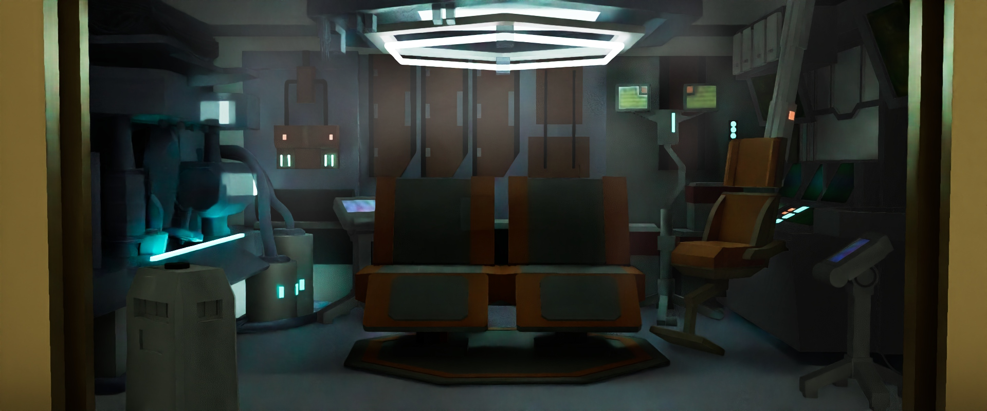
Final Renders

Slide 7
Team
Sarah Smeltzer
Grace Hough
Layout
Models on right side + trashcan on left
Back Wall
Atmosphere/Effects
Rendering
Pipeline Management/Revision Management
Models on left side
Ceiling
Cables
Emissive Lighting
Rendering
Outliner/Namespace Management

